Slide 1
One-factor interest rate model
  There are different types of continuous-time stochastic processes used in interest-rate modeling
  In all of these models because time is a continuous variable, the letter d is used to denote the “change in” some variable
  Specifically, in the models we let
    r = the short rate and therefore dr denotes the change in the short rate
    t = time and thus dt denotes the change in time or equivalently the length of the time interval (for a very small interval of time)
    z = a random term and dz denotes a random process
www.yunikarn.com

Slide 2
Stochastic process
  A basic continuous-time stochastic process for describing the dynamics of the short rate (r) is given by
    dr = bdt + σdz
      dr = the change in the short rate
      b = expected direction of rate change
      dt = the change in time or equivalently the length of the time interval (for a very small interval of time)
      σ = standard deviation of the changes in the short rate
      z = a random term and dz denotes a random process
  The expected direction of the change in the short rate (b) is called the drift term and σ is called the volatility term
  The change in the short rate (dr) over the time interval (dt) depends on the expected direction of the change in the short rate (b) and a random process (dz) that is affected by volatility
www.yunikarn.com

Slide 3
Assumptions
  The random nature of the change in the short rate comes from the random process dz. The assumptions are that
    The random term z follows a normal distribution with a mean of zero and a standard deviation of one (i.e., is a standardized normal distribution)
    The change in the short rate is proportional to the value of the random term, which depends on the standard deviation of the change in the short rate
    the change in the short rate for any two different short intervals of time is independent
  The expected value of the change in the short rate is equal to b, the drift term
    In the special case where the drift term is zero and the variance is one, it can be shown that the variance of the change in the short rate over some interval of length T is equal to T and therefore the standard deviation is the square root of T.
www.yunikarn.com

Slide 4
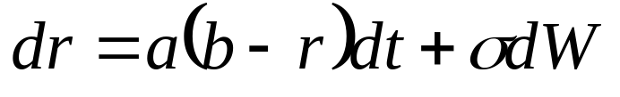
The Vasicek (1977) model
  This process exhibit a mean-reverting feature
  The parameter b may be regarded as the equilibrium level of the short-term interest rate, around which it stochastically evolves
  When r falls far below (above) its long-term value b, the expected instantaneous variation of r is positive (negative)
  In this case, the short-term rate will tend to move up (down)
  It will move towards its long-term value quickly when it is far from it and when the parameter a (speed of return to the long-term mean value) is high
www.yunikarn.com

